Slide 1
Twitter Sentimental Analysis Using Ordinal Regression

Slide 2
Abstract
Research on Twitter sentiment analysis, which analyzes Twitter data (tweets) to extract user sentiments about a topic, has grown rapidly. Many researchers prefer the use of machine learning algorithms for such analysis. This study aims to perform a detailed sentiment analysis of tweets based on ordinal regression using machine learning techniques. The proposed approach consists of first pre-processing tweets and using a feature extraction method that creates an efficient feature. Then, under several classes, these features scoring and balancing. Multinomial logistic regression (SoftMax), Support Vector Regression (SVR), Decision Trees (DTs), and Random Forest (RF) algorithms are used for sentiment analysis classification in the proposed framework.

Slide 3
Introduction
With the rapid development of social networks and microblogging websites. Microblogging websites have become one of the largest web destinations for people to express their thoughts, opinions, and attitudes about different topics [1], [2]. Twitter is a widely used microblogging platform and social networking service that generates a vast amount of information. In recent years, researchers preferably made the use of social data for the sentiment analysis of people’s opinions on a product, topic, or event. Sentiment analysis, also known as opinion mining, is an important natural language processing task. This process determines the sentiment orientation of a text as positive, negative, or neutral Twitter sentiment analysis is currently a popular topic for research.

Slide 4
Software Requirements
Hardware Requirements :-
Operating System supported by
1. Windows 7
2. Windows XP
3 . Windows 8
Processor – Pentium IV or higher
RAM -- 256 MB
Space on Hard Disk -- Minimum 512 MB
Software Requirements :-
For developing the Application
1. Python
2. Django
3. Mysql
4. Mysqlclient
5. WampServer 2.4
Technologies and Languages used to Develop
-- Python

Slide 5
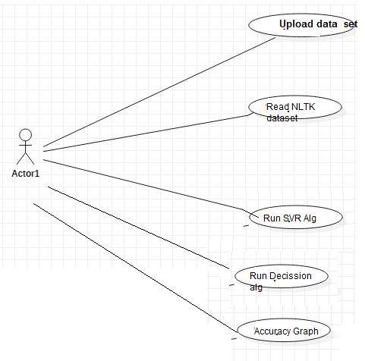
Analysis and Design
This chapter provides the design phase of the Application. To design the project, we use the UML diagrams. The Unified Modelling Language (UML) is a general- purpose, developmental, modelling language in the field of software engineering that is intended to provide a standard way to visualize the design of a system.
Use Case Diagram

Slide 6
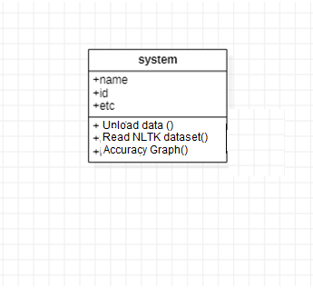
Class Diagram
The above mentioned class diagram represents the Chatbot system workflow model. This diagram has class models with class names as
User
Admin
Home screen

Slide 7
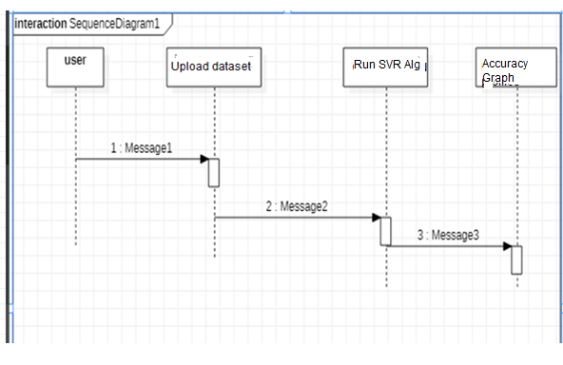
Sequence Diagram

